Slide 1
Integrating Any Existing Web App Into Salesforce
Using Canvas to Quickly Bring Your Existing App to Salesforce
Jason Young
Lead Developer
jason@dayback.com
@terapicodata

Slide 2
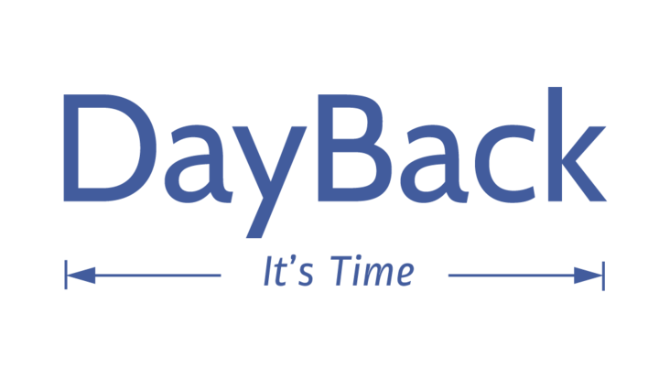
Jason Young
Lead Developer, DayBack
Notes:
Jason Young
Lead Developer DayBack

Slide 3
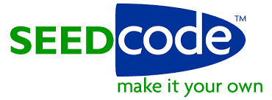
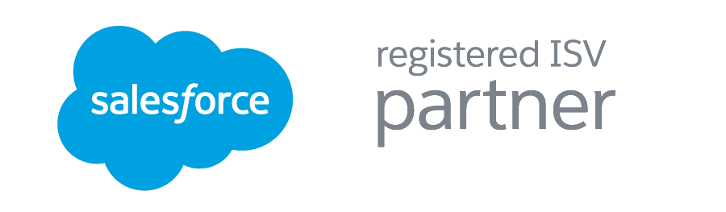
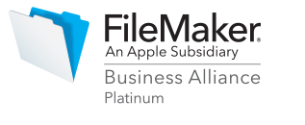
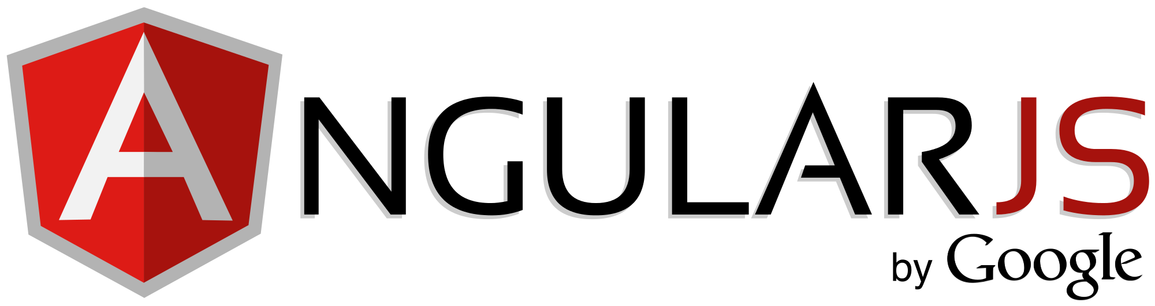
About DayBack
SeedCode, Inc.
New To Salesforce
5 Star Rated Calendar App on the AppExchange
Leading Application Developer for Apple’s FileMaker Platform
Angular Shop
Notes:
Dayback is the child of seedcode
New To Salesforce
5 Star Rated Calendar App - The fact that we have our app up on the app exchange is probably the best testament to the canvas platform

Slide 4
Forward-Looking Statements
Statement under the Private Securities Litigation Reform Act of 1995:
This presentation may contain forward-looking statements that involve risks, uncertainties, and assumptions. If any such uncertainties materialize or if any of the assumptions proves incorrect, the results of salesforce.com, inc. could differ materially from the results expressed or implied by the forward-looking statements we make. All statements other than statements of historical fact could be deemed forward-looking, including any projections of product or service availability, subscriber growth, earnings, revenues, or other financial items and any statements regarding strategies or plans of management for future operations, statements of belief, any statements concerning new, planned, or upgraded services or technology developments and customer contracts or use of our services.
The risks and uncertainties referred to above include – but are not limited to – risks associated with developing and delivering new functionality for our service, new products and services, our new business model, our past operating losses, possible fluctuations in our operating results and rate of growth, interruptions or delays in our Web hosting, breach of our security measures, the outcome of any litigation, risks associated with completed and any possible mergers and acquisitions, the immature market in which we operate, our relatively limited operating history, our ability to expand, retain, and motivate our employees and manage our growth, new releases of our service and successful customer deployment, our limited history reselling non-salesforce.com products, and utilization and selling to larger enterprise customers. Further information on potential factors that could affect the financial results of salesforce.com, inc. is included in our annual report on Form 10-K for the most recent fiscal year and in our quarterly report on Form 10-Q for the most recent fiscal quarter. These documents and others containing important disclosures are available on the SEC Filings section of the Investor Information section of our Web site.
Any unreleased services or features referenced in this or other presentations, press releases or public statements are not currently available and may not be delivered on time or at all. Customers who purchase our services should make the purchase decisions based upon features that are currently available. Salesforce.com, inc. assumes no obligation and does not intend to update these forward-looking statements.
Notes:
Before I get started I want to take a second to point out that when considering future developments, you should always base for decisions on what’s currently available.

Slide 5

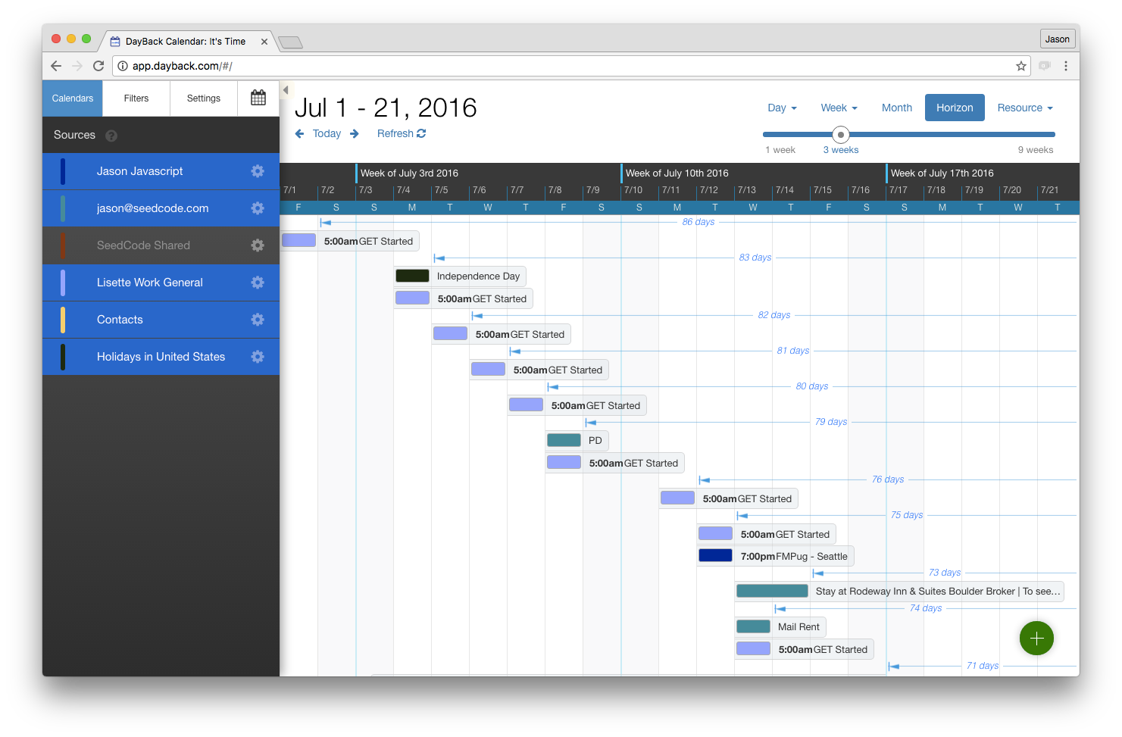
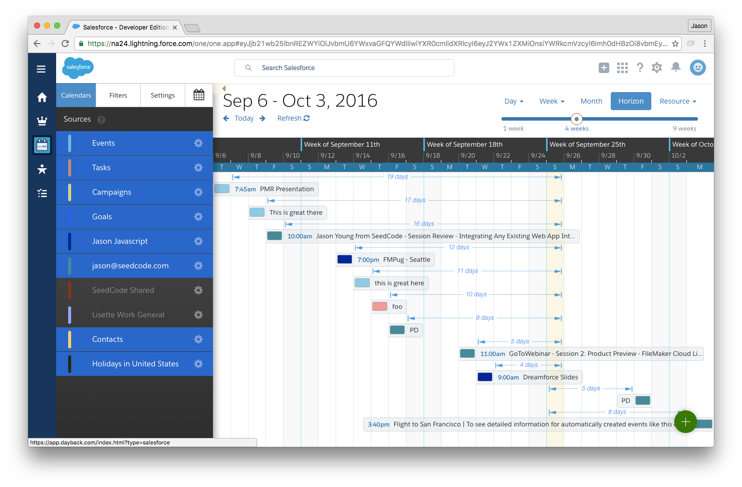
Why Canvas?
Existing Web Application
Canvas
Notes:
switch to browsers after this slide

Slide 6
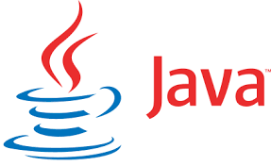



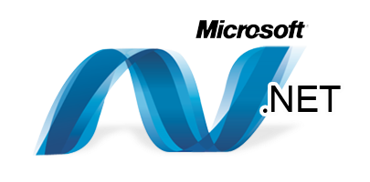
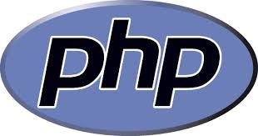
Why Canvas?
Language Independent
No Apex Required To Get Started
Notes:
More reasons. Canvas is language independent, and you can build a fully functioning app with no Apex, so Canvas was ideal for us to introduce ourselves to the Salesforce community.

Slide 7
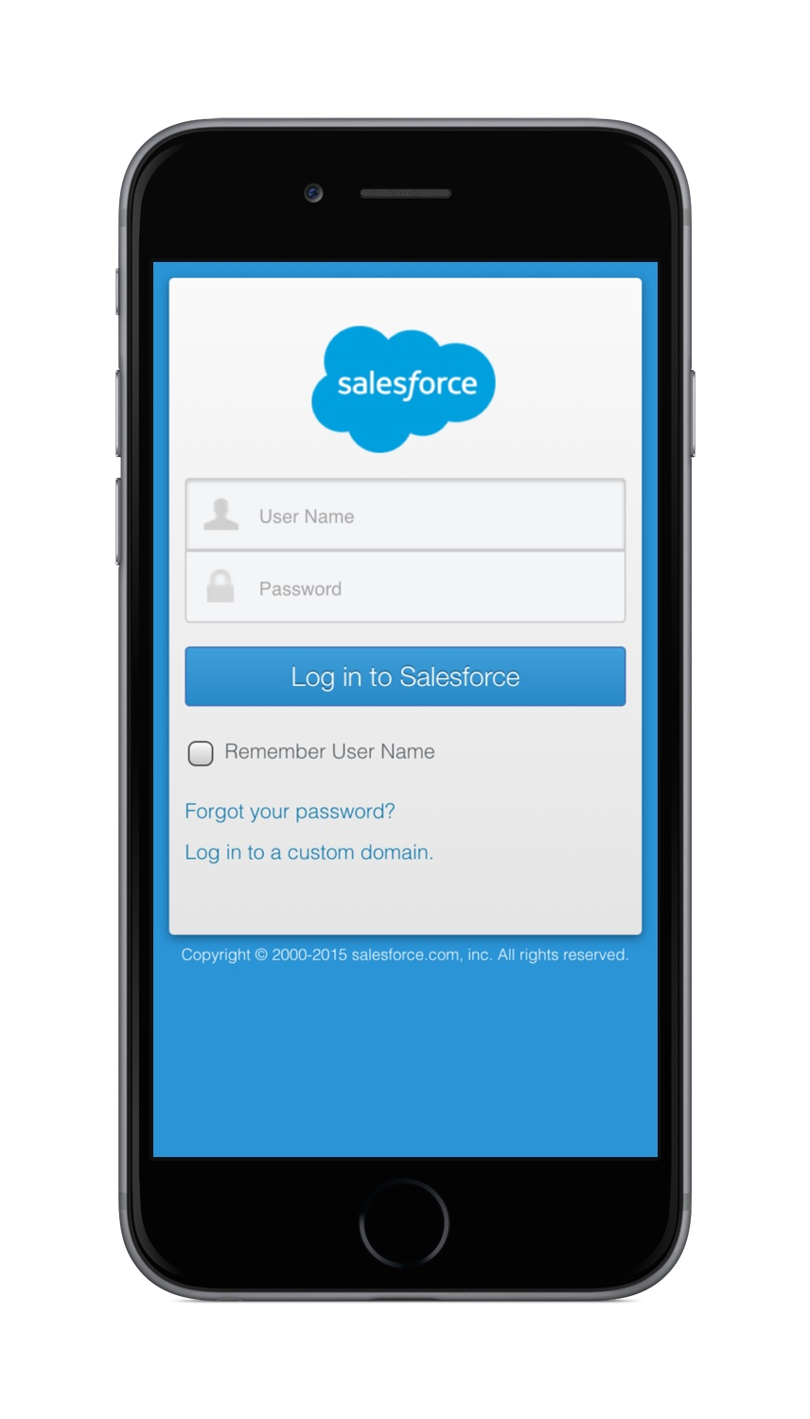
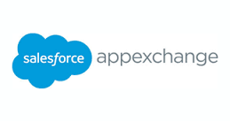

Why Canvas?
Outstanding Integration Features Provided
Authentication
License Management
Canvas Javascript SDK
Notes:
Canvas allows users to access your app by authentication into their Salesforce Orgs.
App exchange manages license allocation
Probably most importantly, the JavaScript SDK, which I’ll talk a little more about.

Slide 8

The Bonus Reasons
Deployment
Seamless
Delivery
Web App Updates Don’t Require New Package
Continuous
On Your Schedule
Yearly Security Review
Notes:
Bonus reasons!! The benefits that weren’t as obvious when we get started.
Develop and deploy new builds of your web app / Changes to the Web App don’t require a new security review.
Security reviews are done yearly.
Means you can continuously develop and improve your app and deliver on schedule.

Slide 9
The Bonus Reasons
CRUD Library
JavaScript SDK Does a Lot of the Work
Ajax Functionality with Excellent Error Capture
Apex Equivalent?
JavaScript
Is Eating The World!
Notes:
The Javascript SDK provides toy with a full featured CRUD library.
AJAX function with excellent error capture and consistently formatted results.
Is there an equivalent apex library that does as much? If so I haven’t seen it and you’re doing a lot of this work from scratch.

Slide 10

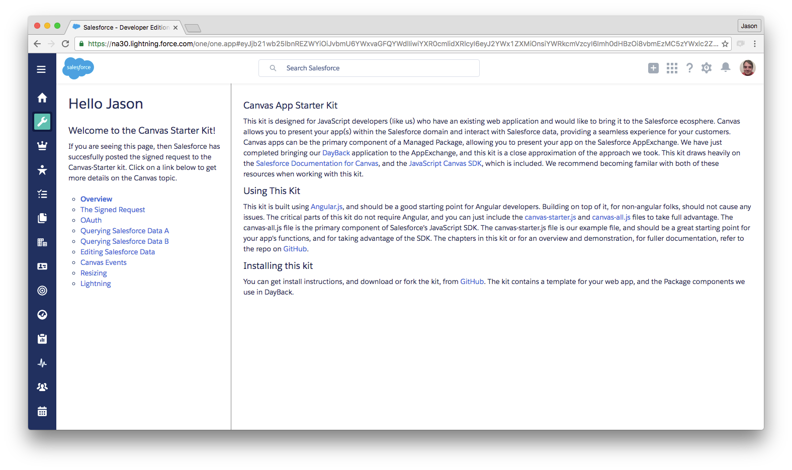
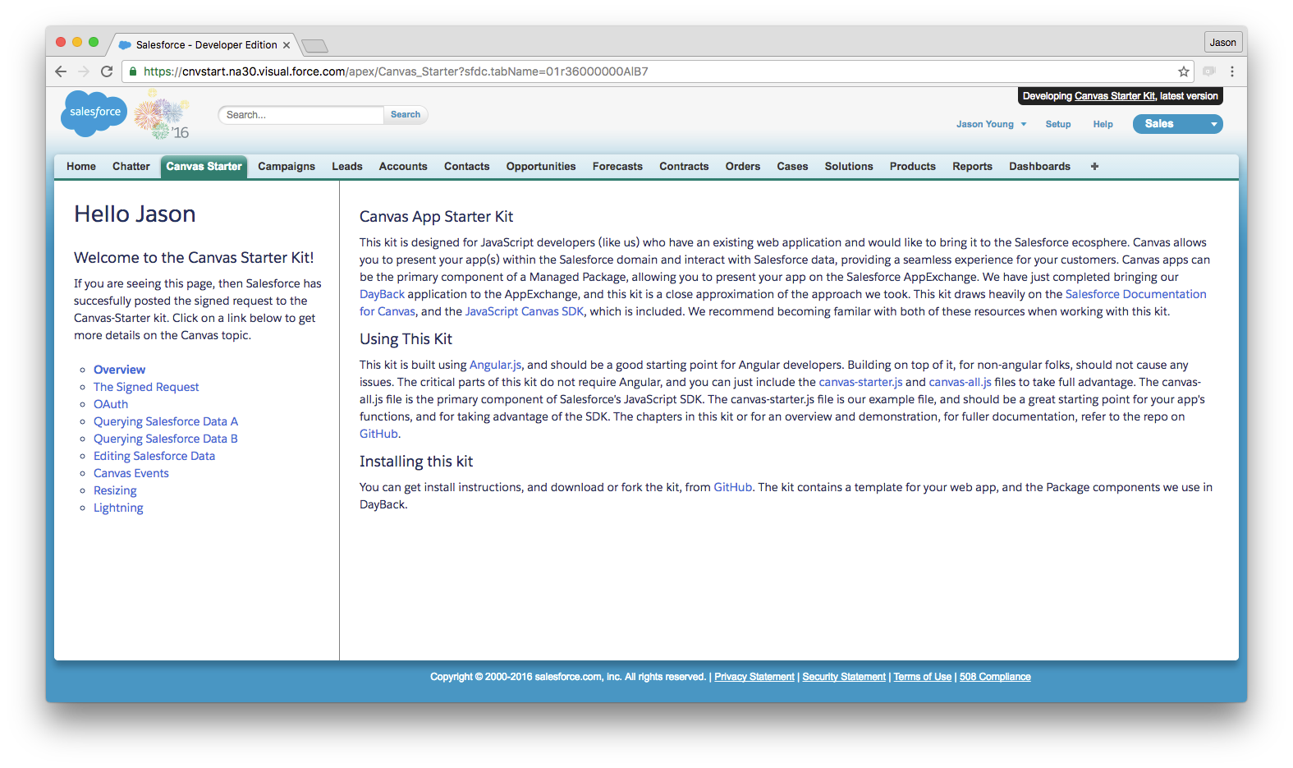
The Bonus Reasons
Lightning & Visualforce
Notes:
Canvas apps in visualforce pages work great in Lightning or Visualforce with just a little css and javascript branching. Deliver the same app / same code base to both platforms. Visualforce table can be easily added to Lightning Navigation Menus.

Slide 11
The Bonus Reasons
Minimal Server Side Footprint
Signed Request Is a simple POST
Simple HTML Page as OAuth Callback Handler
Not Far!
To Integrate Your App
Notes:
Regardless of your platform, Canvas’ requirements are very small. You do need a server side process, but all it has to do is handle a simple POST from Salesforce. You also need an html callback page for the OAuth flow that might be required.

Slide 12
Packaging Our Canvas App
Going To Market
Small Footprint in Salesforce
Just a Few Components Required
Visualforce Page
Static Resources
To Frame Your App
Connected App
Simple JavaScript and CSS
To Manage Authorization
Notes:
Once you’re ready, Packaging your app is pretty easy.
In the salesforce app itself you only need a few components.
A Connected App…
A Visualforce Page….
Some CSS and Javascript to handle oh your canvas app fits in the tab and resizing (this is where you branch for lightning vs. visualforce)

Slide 13


Security Review
Focus on the Web App
Yearly Review
Stress Free Force.Com Source Scan
OWASP (Open Web Application Security Project)
You Should Be Doing This Anyway!!!!
ZAP (Zed Attack Proxy)
Tested Inside and Out
Notes:
Once the app is packaged, you submit to Salesforce for security review. Since we just have a few components in Salesforce, that part is quick and easy ( stress free scan)
OFFICE HOURS
Focus is on you app. Tested with the OWASP standard DO THIS ANYWAY!!!
We used Zap, but I know Salesforce also provides Chimera, but the security review team was fine with ZAP.
Tested inside and out, a lot of value for us outside of salesforce…proudly tell our non-salesforce customers.

Slide 14
The JavaScript SDK
A Familiar Face
AJAX Function handles CORS (cross origin resource sharing)
Same Origin Policy
Notes:
I wanted to say a few more things about the Javascript SDK.
Ajax functionality to get around making cross domain calls from you app’s domain to Salesforce, right from the Javascript
More common, e.g. Google provides a similar kit where you can do calls without a server proxy.
Ideal for a shop like ours that wants to focus on developing in Angular.

Slide 15
The JavaScript SDK
A Familiar Face
Visualforce Client Controller Allows Two-Way Communication
Familiar Publish-Subscribe Model
PubSub
Notes:
Javascript SDK also provides Publication Subscription model for communication between your app and salesforce for non REST stuff, like navigation.

Slide 16
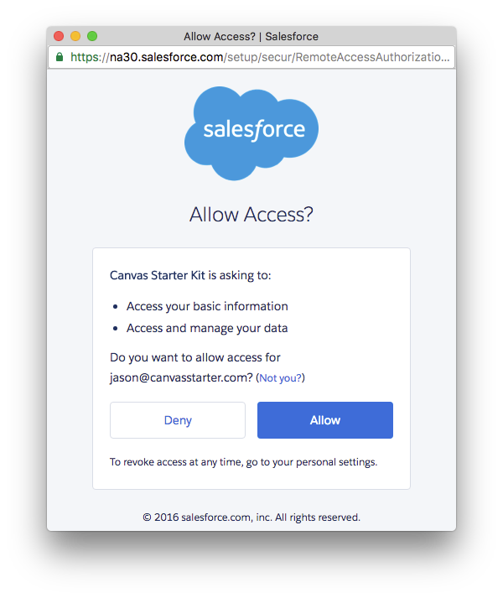
The JavaScript SDK
A Familiar Face
OAuth Functions For Popup Management
Notes:
Javascript idk also provides simple functions for authorizing the app,
so AJAX, pub/sub and OAUth all built into the library.

Slide 17




A Canvas Starter Kit
A Template For Us (Last Year)
JavaScript Centric
Approachable
Coding is Sharing
-@PracticalDev
Notes:
Once we finished, we wanted to capture this in a Canvas starter kit, and we built it for us last year.
Focus on Javascript (minimal server side processes)
Approachable! (Start breaking stuff)The Java based example that Salesforce provides is excellent, but maybe a little intimidating. Ours is a simple PHP page, that we actually lifted from another repo.
Coding is sharing. Long history for us, introduces us to people, and we honestly believe all developers benefit when we can contribute to a platform.

Slide 18
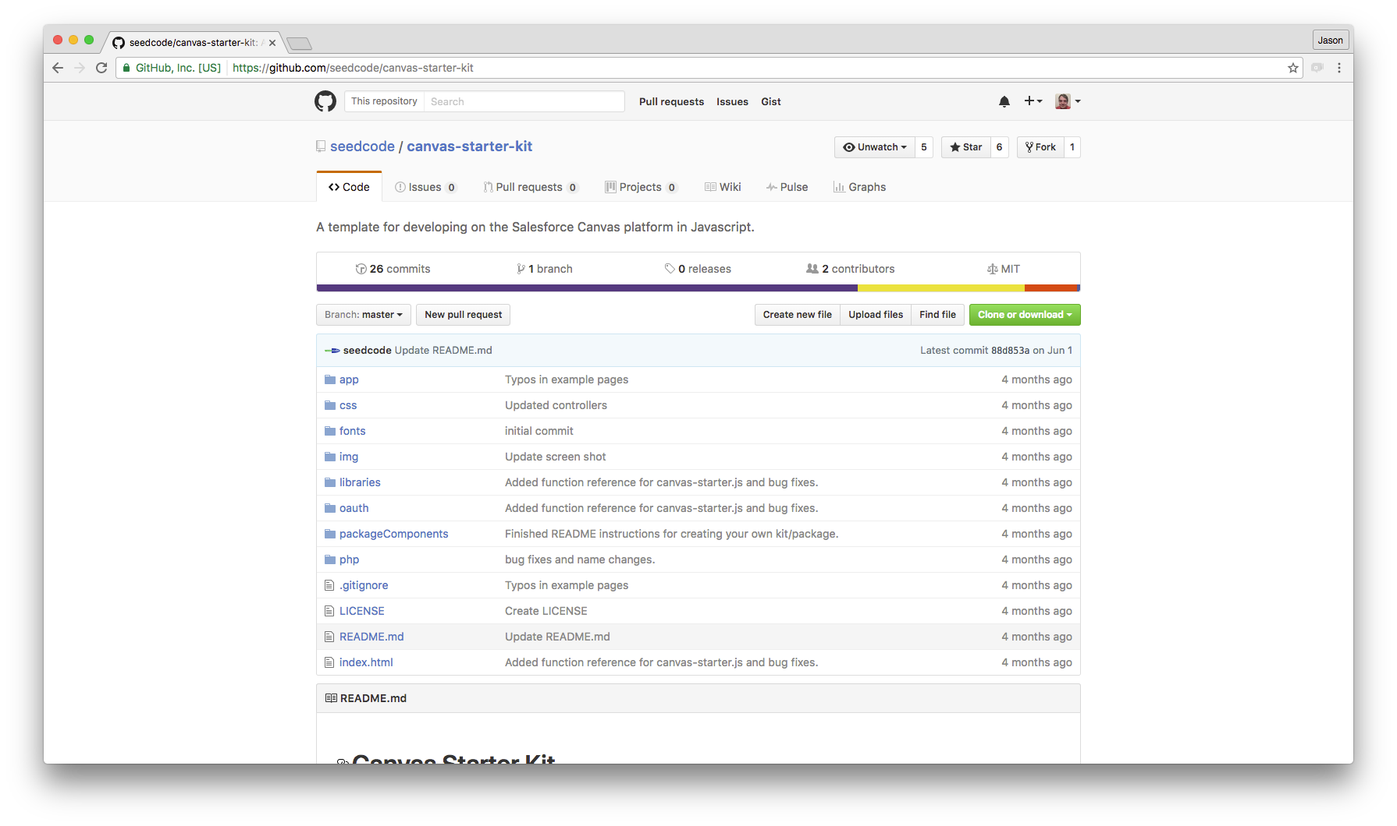
A Canvas Starter Kit
Coding is Sharing
Canvas Apps Can’t Be Unmanaged
Open Source Managed Package
All Locked Components in GitHub Repo
Notes:
We wanted to do an unmanaged package that people could install, but Canvas apps can’t be unmanaged.
Second best thing.
TO DEMOS

Slide 19
Links
Canvas Starter Kit
https://github.com/seedcode/canvas-starter-kit
JavaScript SDK
https://github.com/forcedotcom/SalesforceCanvasJavascriptSDK
DayBack
http://app.dayback.com
Canvas Developers Guide
https://resources.docs.salesforce.com/sfdc/pdf/canvas_framework.pdf

Slide 20
Q&A
Jason Young
Lead Developer, DayBack
jason@dayback.com
@terapicodata

